Slide 1

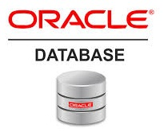
Oracle database
Lecture 46

Slide 2

Today’s Agenda
Introduction To Packages
Benefits
Components Of A Package
Examples
Dropping Package

Slide 3
Introduction To Packages
A package is a way of logically storing the subprograms like procedure, function or cursor into a single common unit.
A package can be defined as an Oracle object that is compiled and stored in the database.
Once it is compiled and stored in the database it can be used by all the users of database who have executable permissions on Oracle database.

Slide 4
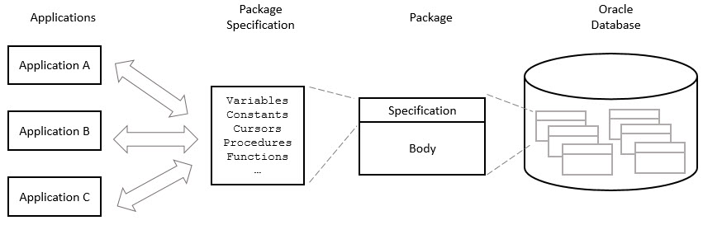
Introduction To Packages

Slide 5
Benefits Of Using A Package
REUSABILITY: Whenever a package is created, it is compiled and stored in the database. So, we write the code once which can be reused by other applications.
OVERLOADING: Two or more procedures or functions can be created in a package with the same name.
IMPROVES PERFORMANCE: Package code gets loaded inside the SGA(system global area) of Oracle at first call itself due to which other subsequent calls will work very fast.

Slide 6
Components Of A Package
Package has two basic components:
Specification: It is the declaration section of a Package
Body: It is the definition section of a Package.

Slide 7
Package Specification
The package specification is where we declare public items.
The scope of package items is the schema of the package.
In other words, we can access items declared in a package specification from anywhere in the schema e.g., we can access items in a package specification from other packages.

Slide 8
Package Specification
A package specification does not contain any implementations of the public items.
For example, in case of procedures or functions, the package specification contains only their headers, but not their bodies.

Slide 9
Syntax Of Package Specification
CREATE OR REPLACE PACKAGE package_name IS | AS variable_declaration ... ;
constant_declaration ...;
exception_declaration ...;
cursor_specification ...;
PROCEDURE procedure_name (param_name [IN|OUT|IN OUT] datatype ,…);
FUNCTION function_name (param_name [IN|OUT|IN OUT] datatype ,…)RETURN datatype ;
END package_name;

Slide 10
Package Body
If the package specification has cursors or subprograms, then the package body is mandatory.
Otherwise, it is optional.

Slide 11
Syntax Of Package Body
CREATE OR REPLACE PACKAGE BODY <package_name> IS/AS
FUNCTION <function_name> (<list of arguments>) RETURN <datatype>IS/AS
-- local variable declaration;
BEGIN
-- executable statements;
EXCEPTION
-- error handling statements;
END <function_name>;
PROCEDURE <procedure_name> (<list of arguments>)IS/AS
-- local variable declaration;
BEGIN
-- executable statements;
EXCEPTION
-- error handling statements;
END <procedure_name>;
END <package_name>;

Slide 12
Using A Package
Creating a package only defines it, to use it we must refer it using the package object.
Following is the syntax for referring a package object:
Packagename.objectname;
The Object can be a function, procedure, cursor, exception that has been declared in the package specification and defined in the package body

Slide 13
Example
Below we have a table called Students with Student's data in it.
Create a package called Student_pkg containing a procedure called update_course to update the course name for a student with given roll no and a function called delete_stud to remove a student of given roll no.
ROLLNO | SNAME | AGE | COURSE
11 | Anu | 20 | BSC
12 | Asha | 21 | BCOM
13 | Arpit | 18 | BCA
14 | Chetan | 20 | BCA

Slide 14
Solution ( Package Spec)
CREATE OR REPLACE PACKAGE pkg_student IS
PROCEDURE update_course (sno students.rollno%type , cname students.course%type);
FUNCTION delete_stud (sno students.rollno%type) RETURN boolean;
END pkg_student;

Slide 15
Solution ( Package Body)
CREATE OR REPLACE PACKAGE BODY pkg_student IS PROCEDURE update_course (sno students.rollno%type, cname students.course%type)IS
BEGIN
Update students set course=cname where rollno=sno;
IF SQL%FOUND THEN
dbms_output.put_line('RECORD UPDATED');
ELSE
dbms_output.put_line('RECORD NOT FOUND'); END IF;
END updateRecord;

Slide 16
Solution ( Package Body)
FUNCTION delete_stud (sno students.rollno%type) RETURN boolean IS
BEGIN
Delete from student where rollno=sno;
RETURN SQL%FOUND;
END deleteRecord;
END pkg_student;

Slide 17
Calling
DECLARE
sno student.rollno%type;
cname student.course%type;
BEGIN
sno := &sno;
cname:=‘&course’;
pkg_student.update_course(sno,cname);
IF pkg_student.delete_stud(sno) THEN dbms_output.put_line('RECORD DELETED');
ELSE
dbms_output.put_line('RECORD NOT FOUND');
END IF;
END;

Slide 18
Overloading
When more than one program in the same scope share the same name, the programs are said to be overloaded.
PL/SQL supports the overloading of procedures and functions in package specifications and bodies.

Slide 19
Overloading
Each overloaded version must differ from all other overloaded versions in at least one of the following respects:
Number of parameters
Order of the parameters
Data types of the parameters

Slide 20
Example
CREATE OR REPLACE PACKAGE addition IS
FUNCTION adding (n integer,m integer) RETURN integer;
FUNCTION adding (n date,m integer) RETURN date;
END addition;

Slide 21
Example
CREATE OR REPLACE PACKAGE BODY addition IS
FUNCTION adding (n integer,m integer) RETURN integer IS BEGIN return n+m; END;
FUNCTION adding (n date,m integer) RETURN date IS BEGIN return n+m; END;
END addition;

Slide 22
Calling
BEGIN
dbms_output.put_line(‘adding 3 and 6 using overloaded function adding:’ || addition.adding(3,6));
dbms_output.put_line(’10 days from today using overloaded function adding:’ || addition.adding(sysdate,10));
END;

Slide 23
Dropping A Package
To drop a package, we use the DROP PACKAGE statement with the following syntax:
DROP PACKAGE [BODY] package_name;
If we want to drop only the body of the package, we need to specify the BODY keyword.
If we omit the BODY keyword, then the statement drops both the body and specification of the package.

